Slide 1
Transforming the Hospital into a Trauma-Informed Environment
(and How That Can Improve the Patient and the Family Experience)

Slide 2
Objectives
Recognize how a history of psychological trauma can impact a patient (or family member) during admissions for acute illnesses and be aware of the different trauma responses individuals may exhibit while in the hospital.
Transform SAMHSA’s four key elements and six key principles of trauma-informed care into a readiness for seeing patients and caregivers with a mindset of, “What happened to you?” instead of “What is wrong with you?”
Practice trauma-informed care as a universal precaution to improve care, enhance the overall experience for patients and families, and assuage the secondary trauma that providers may also endure.
Notes:
Explain this is a workshop
Brief talk for 5-10 minutes
Split into group for 25-30 minutes minutes
Have a group discussion for 20 minutes

Slide 3
What is the most emotionally challenging/difficult type of patient that you care for?
Notes:
While the workshop focuses on patients, being trauma informed can help us too. Should introduce a story that you can get back to how at the end.
This is a little icebreaker to get people thinking… hopefully will elicit provider distress, which we will wrap up at the end by addressing.
I usually provide my own story of a distressing encounter and then at the end talk about how TIC helps keep me centered.

Slide 4
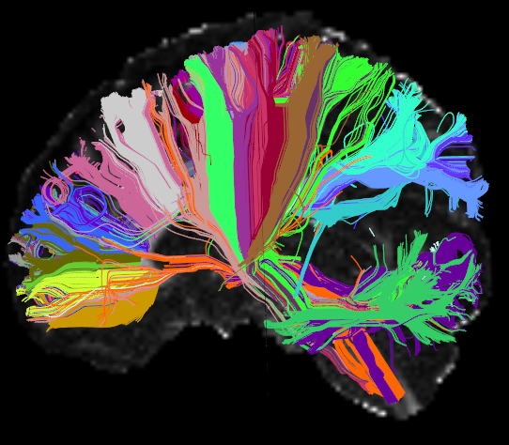
“When individuals are bombarded with repeated traumas that constitute threats to his or her personal integrity and worldview, then individuals come to question even the most fundamental assumptions about the world… and construct a new theory of how the world works and how people behave… The world becomes unsafe, dangerous, and confusing.” (Harris & Fallot, 2001)
Notes:
There 3 types of stress: positive, tolerable, toxic.
Trauma is defined by SAMHSA as “An event, series of events, or set of circumstances experienced as by an individual as physically or emotionally harmful and has lasting adverse effects on the person’s functioning and mental, physical, emotional or spiritual well-being”
Important to note that trauma isn’t objective but it’s subjective. Each individual interprets events through the lens of resilience, which is essentially based on relational health

Slide 5
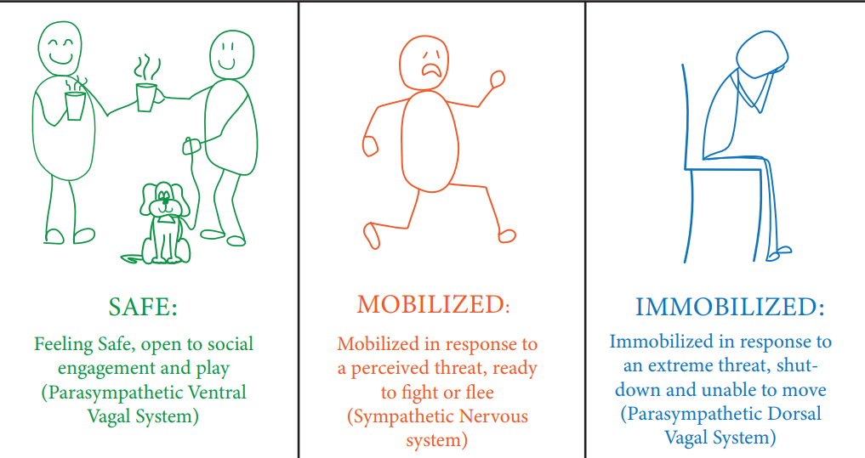
*Images are from the public domain
Notes:
Trauma responses you might see in patients.
FYI Every personal will have their own intimacy barrier and state dependent learning capabilities, based on their developmental trauma history.

Slide 6

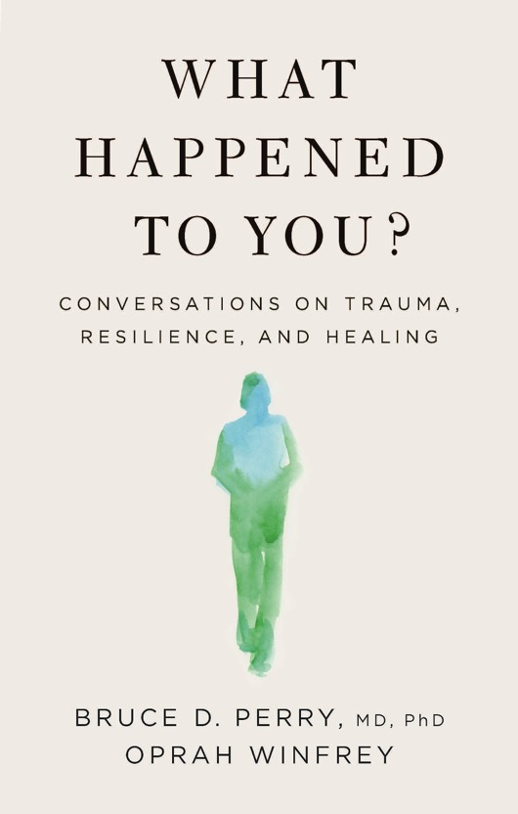
Notes:
Good books to read

Slide 7




Realize the effects of trauma
Recognize trauma responses
Realize
Recognize
Respond
Resist
Resist retraumatization
Respond to trauma
Notes:
Four R’s of trauma informed approach:
Realize the effects of trauma
Recognize trauma responses
Responded to trauma
Resist retraumatization

Slide 8
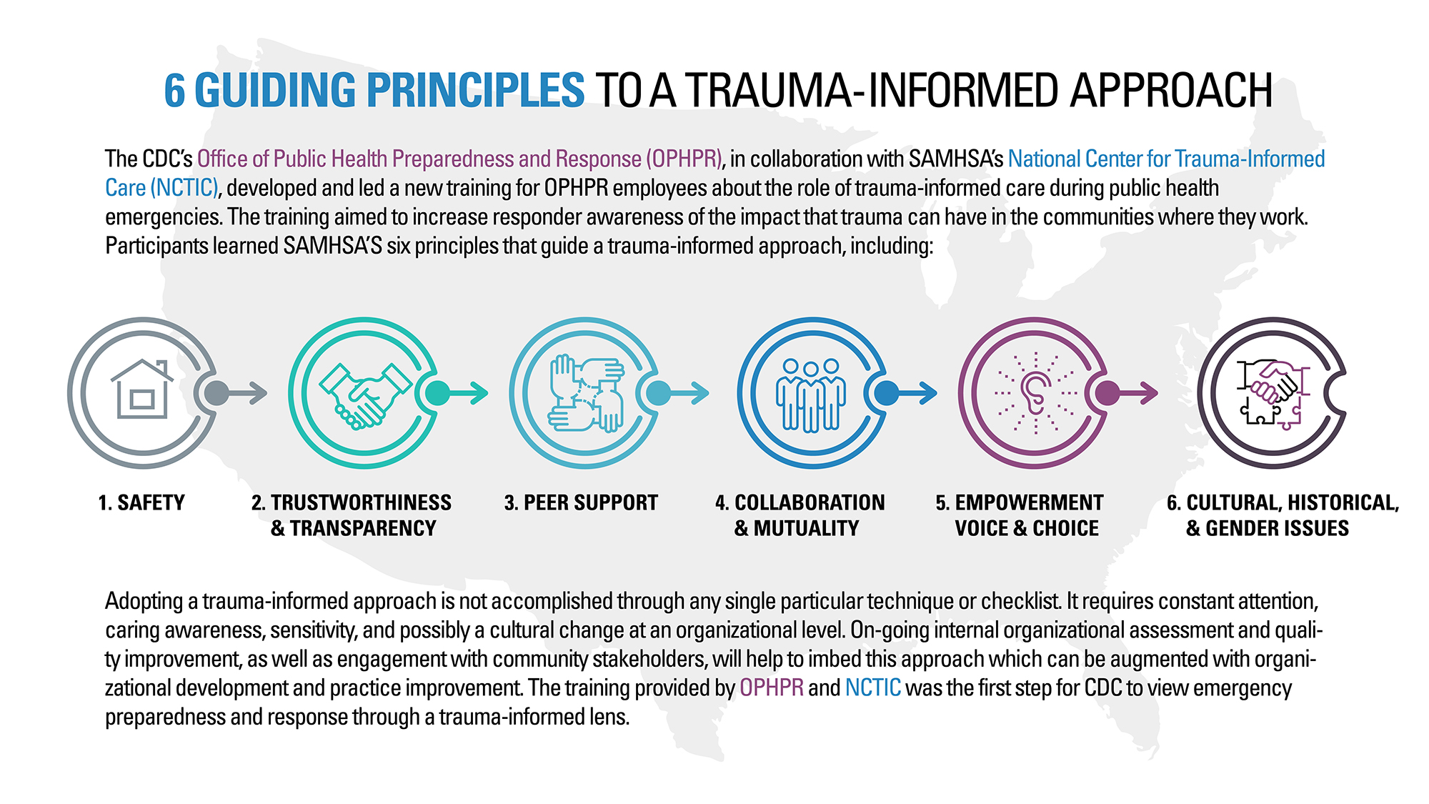

Slide 9
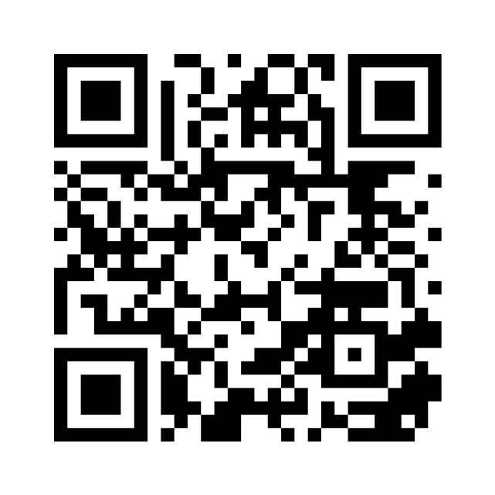
Breakaway activities
Split into role-playing groups of 5
If preferred, you can select from a variety of self-reflection exercises
Using your phone camera, scan the QR code to choose an activity
We will regroup in 25 minutes to discuss key takeaways
QR Code to website with role-playing and individual self reflection exercises. Alternatively, can use paper handouts.
Notes:
An array activities can chose from. There will be group activities and individual activities. Break for 25 minutes for these activities
Break into groups of 5 or individual exercises

Slide 10
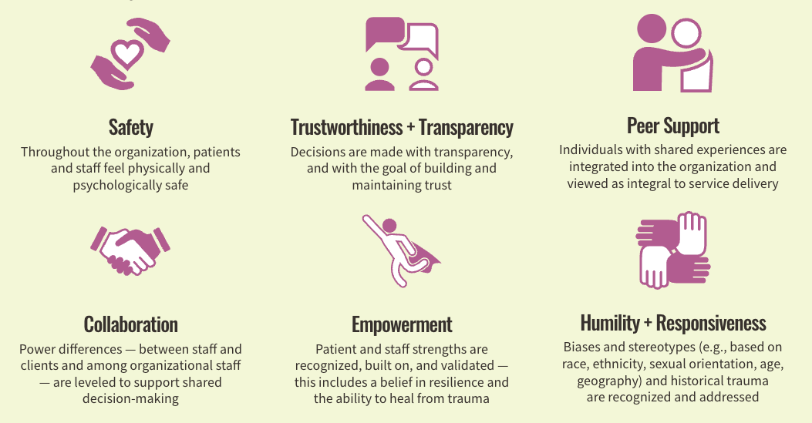
OPEN FORUM
Notes:
Center for healthcare strategies image. Will ask people to come and talk about their activity as it pertains to these 6 principles. 20 minutes.

Slide 11
MEDICE, CURA TE IPSUM…
Notes:
Final slide discusses how being trauma informed can help providers (call back to 1st question), in addition to helping patients.
“Physician, heal thyself”
This image is adapted from information in the book “Trauma Stewardship” by Connie Burk and Laura van Dernoot Lipsky
Vicarious trauma, moral distress, etc are real.
Symptoms of secondary trauma include the circle around the compass
Using the story you told in slide 3 go around the compass showing how TIC helps us be mindful and centered
Eg. Empathy is making the well bigger, not filling it up.
For example “Is this working for me?” If I’m not trauma-informed I can’t provide effective care. And if I don’t then I burn out more.

Slide 12
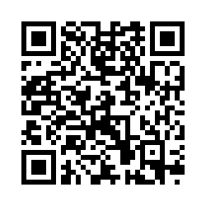
End Logo
PLEASE FILL OUT THIS SURVEY TO PROVIDE FEEDBACK
PLEASE FILL OUT THIS SURVEY TO PROVIDE FEEDBACK
Notes:
The survey will help evaluate the workshop and provide important feedback to improve the website
Also you can provide ideas for making our hospital more trauma informed
At the end of the survey it will give you a link to the website and you can use the website with the attached slides to conduct this workshop wherever. Just take a screenshot of the thank you message with your phone
Please always have people do the evaluation so we can make the website better

